Slide 1
Welcome to CS 2006
Operating Systems
When I will grow, I will teach OS, Woow Grape
*********************************************
Course Instructor: Safia Baloch
Consultant Days: Monday, Thursday
Room: Sir Dr. Rafi’s Neighbour
100% responsive via email: safia@nu.edu.pk

Slide 2
Marks Distribution
Mid1: 15%
Mid2: 15%
Class activities + Assignment+Quizzes: 10%
Projects: 10%
Final: 50%
Book: Operating System Concepts by Abraham Silberschatz 10th Edition

Slide 3
Introduction
Chapter #1

Slide 4
What is System?
Notes:
And What is Computing Systems?

Slide 5
What is an Operating System?
A program that acts as an intermediary between a user of a computer and the computer hardware

Slide 6
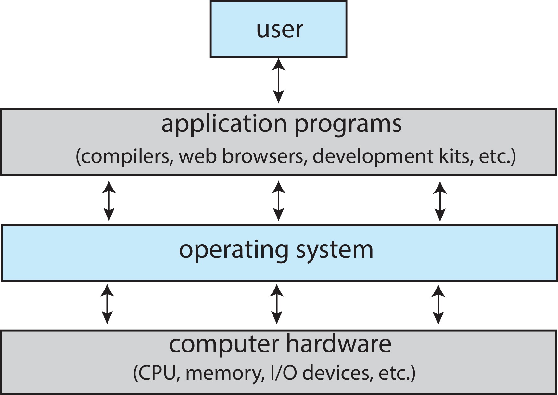
Abstract view of the components of a computer system

Slide 7
Why these Components are important?
H/W
Systems View
User View
Defining Operating Systems
Form of an automation of user based task
Collection of automatic Functions
Function-Kernel?

Slide 8
Computer Startup
bootstrap program is loaded at power-up or reboot
Typically stored in ROM or EPROM, generally known as firmware
Initializes all aspects of system
Loads operating system kernel and starts execution
Notes:
In particular case, how do the windows and linux bootloader coexist?

Slide 9

User-Level
Traps
System-Level
Interrupts

Slide 10
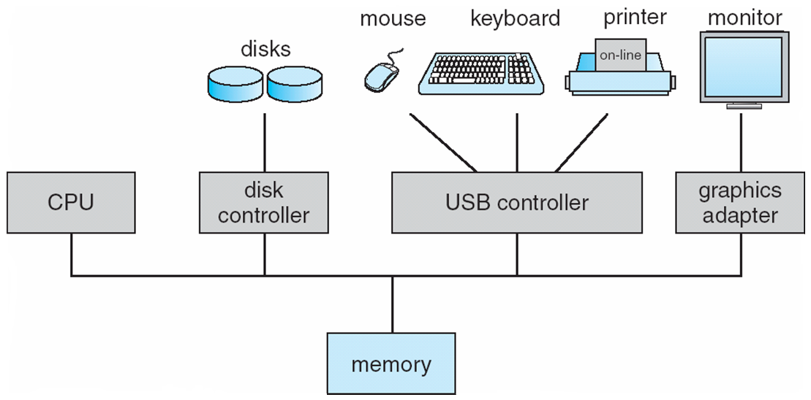

Slide 11
Operating System Definition
OS is a resource allocator
Manages all resources
Decides between conflicting requests for efficient and fair resource use
OS is a control program
Controls execution of programs to prevent errors and improper use of the computer
“The one program running at all times on the computer” is the kernel.

Slide 12
Computer System Organization
Computer-system operation
One or more CPUs, device controllers connect through common bus providing access to shared memory
Concurrent execution of CPUs and devices competing for memory cycles

Slide 13
Computer-System Operation
I/O devices and the CPU can execute concurrently
Each device controller is in charge of a particular device type
Each device controller has a local buffer
CPU moves data from/to main memory to/from local buffers
I/O is from the device to local buffer of controller
Device controller informs CPU that it has finished its operation by causing an interrupt

Slide 15
Common Functions of Interrupts
Interrupt transfers control to the interrupt service routine generally, through the interrupt vector, which contains the addresses of all the service routines
Interrupt architecture must save the address of the interrupted instruction
A trap or exception is a software-generated interrupt caused either by an error or a user request
An operating system is interrupt driven
Notes:
There are many buses within system but the system bus is the main communications path between the major components

Slide 16
Interrupt Handling
The operating system preserves the state of the CPU by storing registers and the program counter
Separate segments of code determine what action should be taken for each type of interrupt

Slide 17
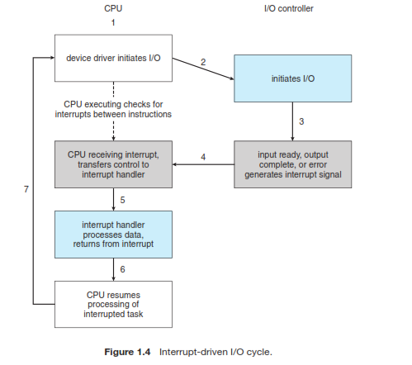
Interrupt Handling

Slide 18
I/O Structure
After I/O starts, control returns to user program only upon I/O completion
Wait instruction idles the CPU until the next interrupt
At most one I/O request is outstanding at a time, no simultaneous I/O processing.
After I/O starts, control returns to user program without waiting for I/O completion
Device-status table contains entry for each I/O device indicating its type, address, and state

Slide 19
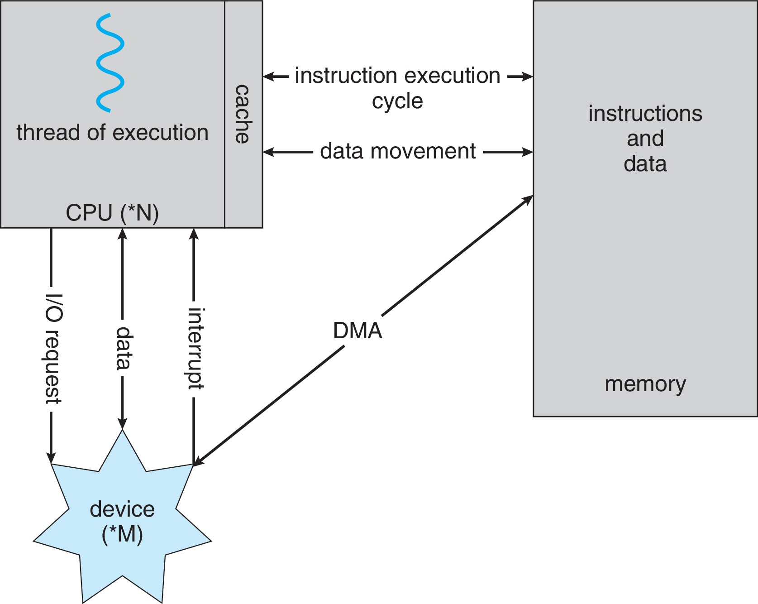
Direct Memory Access Structure
Used for high-speed I/O devices able to transmit information at close to memory speeds
Device controller transfers blocks of data from buffer storage directly to main memory without CPU intervention
Only one interrupt is generated per block, rather than the one interrupt per byte

Slide 20
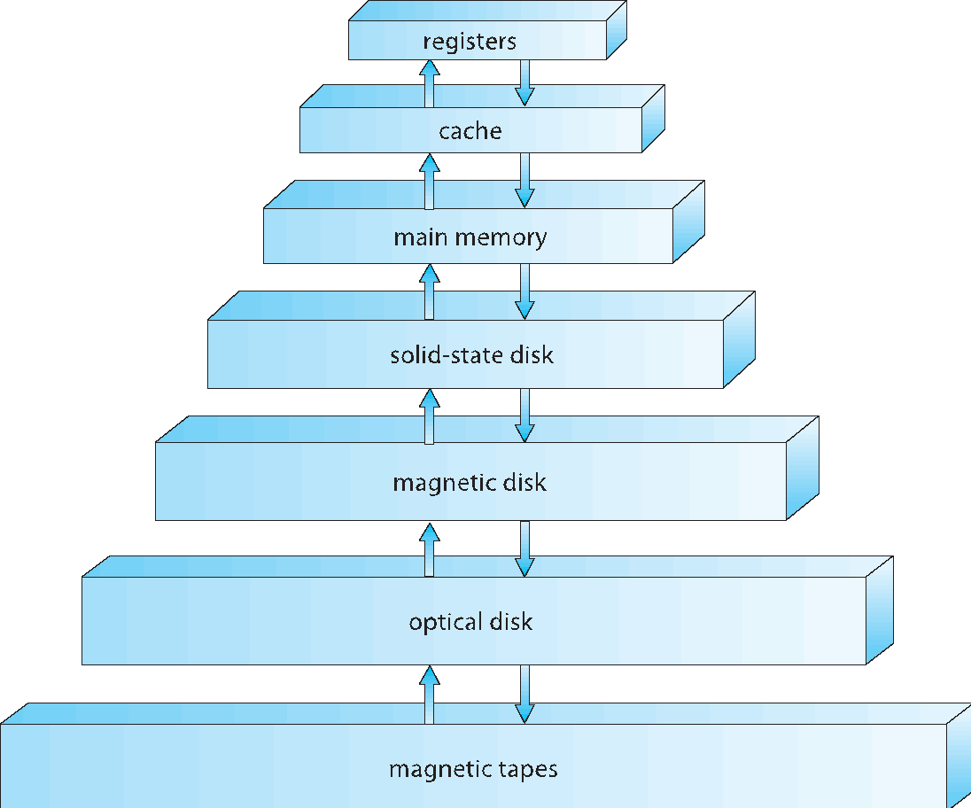
Storage-Device Hierarchy

Slide 21
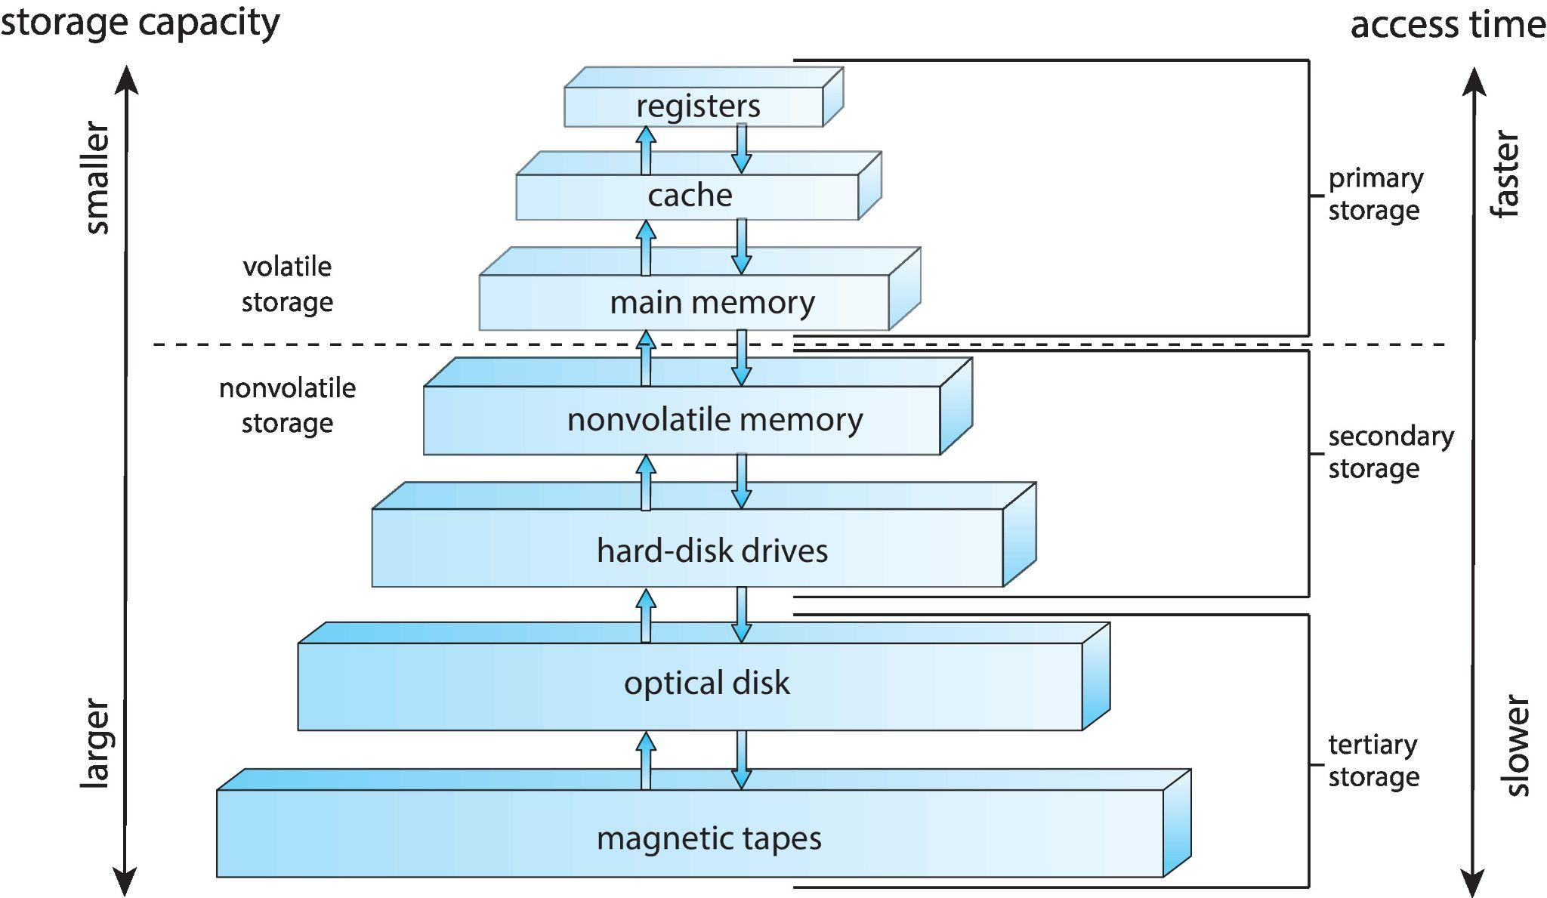

Slide 22
Storage Structure
Main memory(cache,register, ROM) – only large storage media that the CPU can access directly
Secondary storage – extension of main memory that provides large nonvolatile storage capacity
Each level work as a back-up for the levels above it
Upper levels are fast, expensive and volatile
What OS has to do here ?
manage various forms of memory
Notes:
Magnetic disks – rigid metal or glass platters covered with magnetic recording material
Disk surface is logically divided into tracks, which are subdivided into sectors
The disk controller determines the logical interaction between the device and the computer

Slide 23
Storage Hierarchy
Storage systems organized in hierarchy
Speed
Cost
Volatility
Caching – copying information into faster storage system; main memory can be viewed as a cache for secondary storage
Device Driver for each device controller to manage I/O
Provides uniform interface between controller and kernel

Slide 24
Caching
Important principle, performed at many levels in a computer (in hardware, operating system, software)
Faster storage (cache) checked first to determine if information is there
If it is, information used directly from the cache (fast)
If not, data copied to cache and used there

Slide 25
Computer-System Architecture
Single -Processor Systems(uni)
Multiprocessors systems growing in use and importance
Also known as parallel systems, tightly-coupled systems
Advantages include: Home Task
Increased throughput
Economy of scale
Increased reliability – graceful degradation or fault tolerance
Two types:
Asymmetric Multiprocessing
Symmetric Multiprocessing

Slide 26
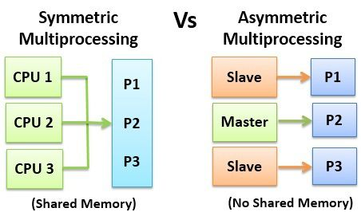
Symmetric vs. Asymmetric Multiprocessing Architecture [1/2]
Notes:
SMP: All core are equal:
Each is made available to perform all the same kinds of work as the others, (i.e OS functions and user app)
Multipro, more or less tightly coupled depending (clocks, cache, memory, component connections)

Slide 27
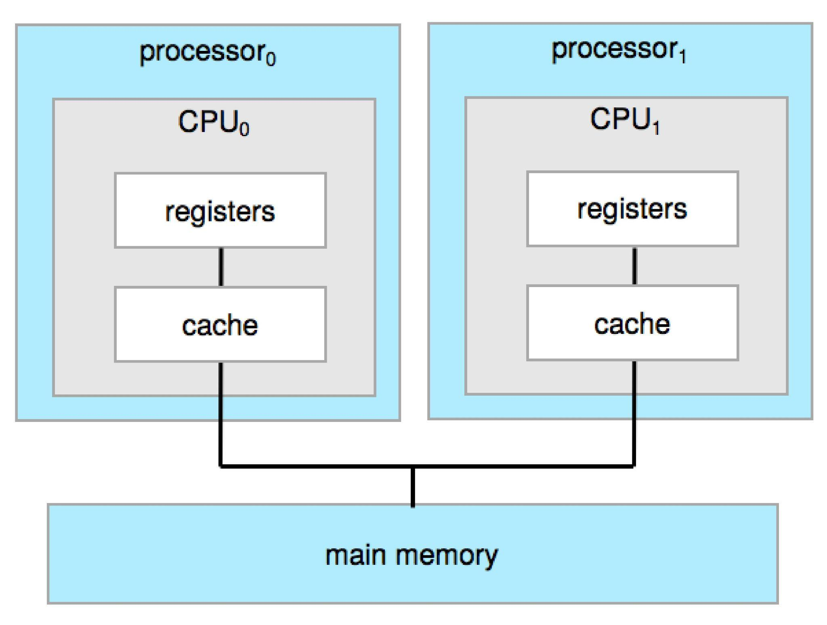
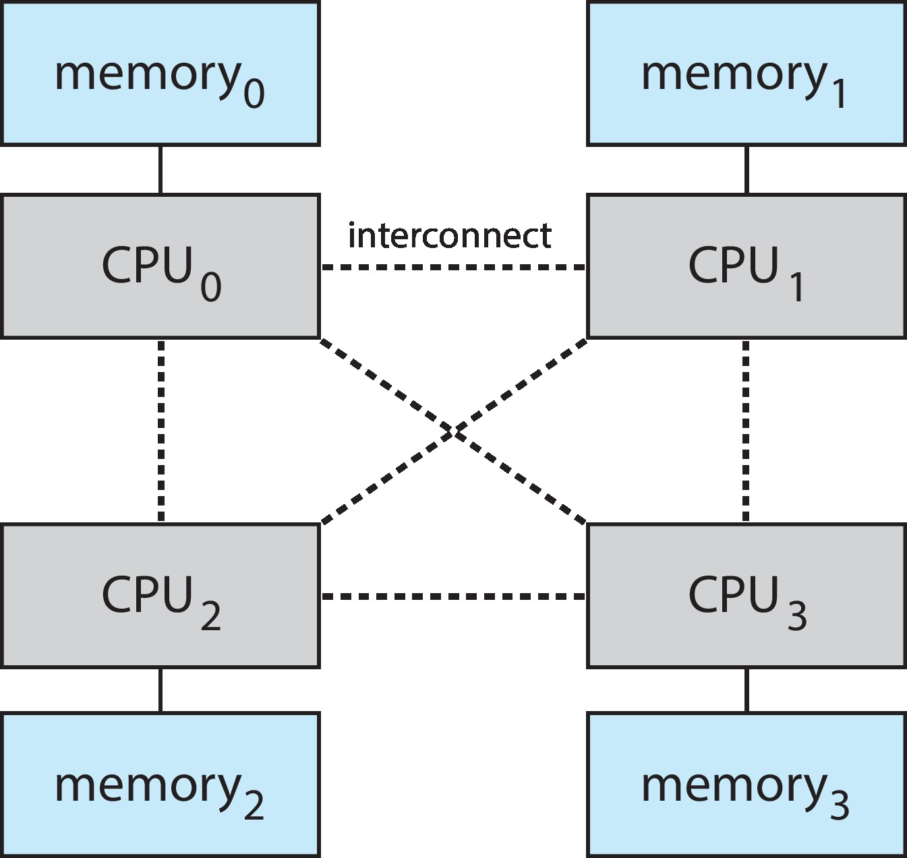
A Dual-Core Design/NUMA multiprocessing architecture

Slide 28
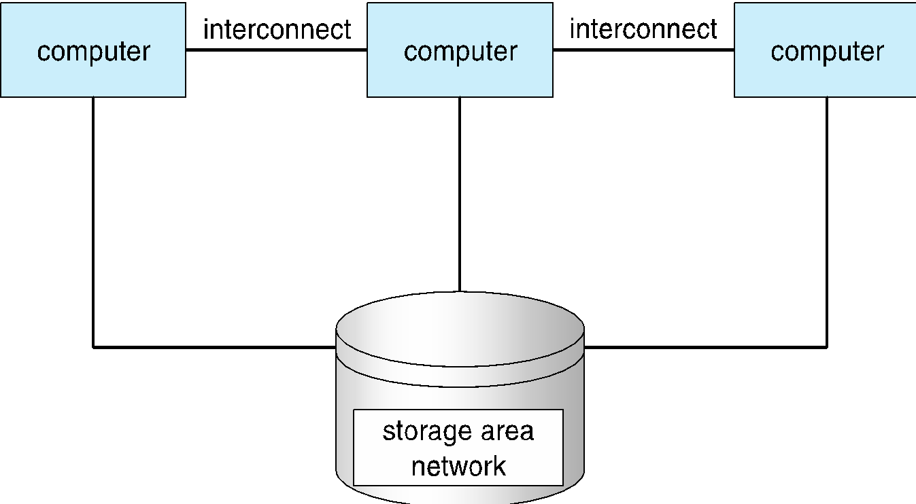
Clustered Systems

Slide 29
Clustered Systems
Like multiprocessor systems, but multiple systems working together (loosely coupled)
Usually sharing storage via a storage-area network (SAN)
Provides a high-availability service which survives failures
Asymmetric clustering has one machine(servers) in hot-standby mode
Symmetric clustering has multiple nodes running applications, monitoring each other

Slide 30
Operating System Structure
Multiprogramming needed for efficiency
Single user cannot keep CPU and I/O devices busy at all times
Multiprogramming organizes jobs (code and data) so CPU always has one to execute
A subset of total jobs in system is kept in memory
One job selected and run via job scheduling
When it has to wait (for I/O for example), OS switches to another job
Timesharing (multitasking) is logical extension in which CPU switches jobs so frequently that users can interact with each job while it is running, creating interactive computing
Response time should be < 1 second
Each user has at least one program executing in memory 🢡process
If several jobs ready to run at the same time 🢡 CPU scheduling
If processes don’t fit in memory, swapping moves them in and out to run
Virtual memory allows execution of processes not completely in memory

Slide 31
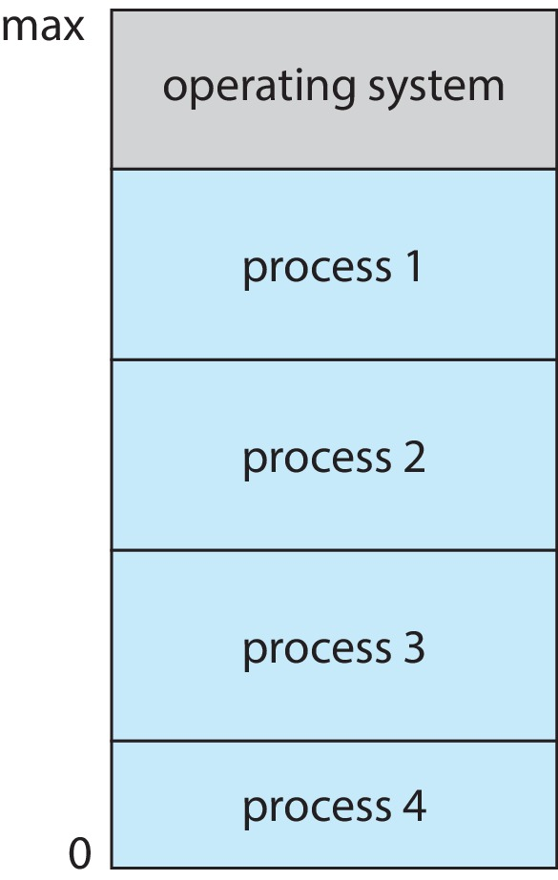
Memory Layout for Multiprogrammed System

Slide 32
Operating-System Operations
Dual-mode operation allows OS to protect itself and other system components
User mode and kernel mode
Mode bit provided by hardware
Provides ability to distinguish when system is running user code or kernel code
Some instructions designated as privileged, only executable in kernel mode
System call changes mode to kernel, return from call resets it to user
Increasingly CPUs support multi-mode operations
i.e. virtual machine manager (VMM) mode for guest VMs

Slide 33
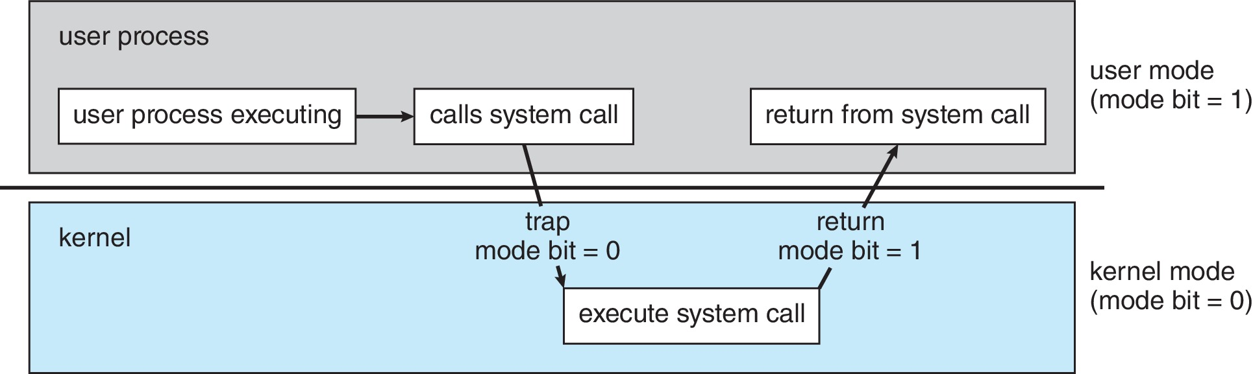
Transition from User to Kernel Mode
Timer (special cpu register)to prevent infinite loop / process hogging resources
Set interrupt after specific period
Operating system decrements counter
When counter zero generate an interrupt
Set up before scheduling process to regain control or terminate program that exceeds allotted time
is it privileged
Different rings(VMM)

Slide 34
Process Management
A process is a program in execution. It is a unit of work within the system. Program is a passive entity, process is an active entity.
Process needs resources to accomplish its task
CPU, memory, I/O, files
Initialization data
Program counter (PC): Contains the address of an instruction to be fetched
Single-threaded process has one program counter specifying location of next instruction to execute
Multi-threaded process has one program counter per thread

Slide 35
Process Management Activities
The operating system is responsible for the following activities in connection with process management:
Creating and deleting both user and system processes
Suspending and resuming processes
process synchronization
process communication
deadlock handling

Slide 36
Memory Management
Memory management activities
Keeping track of which parts of memory are currently being used and by whom
Deciding which processes (or parts thereof) and data to move into and out of memory
Allocating and deallocating memory space as needed

Slide 37
Storage Management
File-System management
Files usually organized into directories
Access control on most systems to determine who can access what
OS activities include
Creating and deleting files and directories
Primitives to manipulate files and dirs
Mapping files onto secondary storage
Backup files onto stable (non-volatile) storage media

Slide 38
Mass-Storage Management
OS activities
Free-space management
Storage allocation
Disk scheduling
Some storage need not be fast
Tertiary storage includes optical storage, magnetic tape
Still must be managed – by OS or applications
Varies between WORM (write-once, read-many-times) and RW (read-write)

Slide 39
I/O Subsystem
I/O subsystem responsible for
Memory management of I/O
caching (storing parts of data in faster storage for performance)
spooling (the overlapping of output of one job with input of other jobs)

Slide 40
Protection and Security
Protection – any mechanism for controlling access of processes or users to resources defined by the OS
Security – defense of the system against internal and external attacks
Huge range, including denial-of-service, worms, viruses, identity theft, theft of service

Slide 41
Computing Environments – Distributed
Distributed
Collection of separate, possibly heterogeneous, systems networked together
Network is a communications path,
Local Area Network (LAN)
Wide Area Network (WAN)
Network Operating System provides features between systems across network

Slide 42
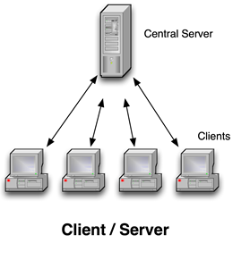
Computing Environments – Client-Server
Client-Server Computing
Dumb terminals supplanted by smart PCs
Many systems now servers, responding to requests generated by clients

Slide 43
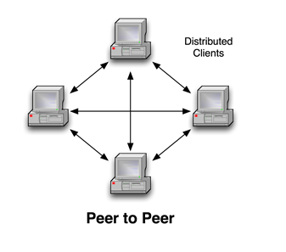
Computing Environments - Peer-to-Peer
Another model of distributed system
P2P does not distinguish clients and servers

Slide 44
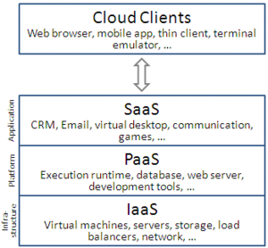
Computing Environments – Cloud Computing

Slide 45
Computing Environments – Real-Time Embedded Systems
Real-time embedded systems most prevalent form of computers
Vary considerable, special purpose, limited purpose OS, real-time OS
Use expanding
Many other special computing environments as well
Some have OSes, some perform tasks without an OS
Real-time OS has well-defined fixed time constraints
Processing must be done within constraint
Correct operation only if constraints met

Slide 46
Mobile Computing
What are the three main purposes of an operating system?
Keeping in mind the various definitions of operating system, consider whether the operating system should include applications such as web browsers and mail programs. Argue both that it should and that it should not, and support your answers.
Which of the following instructions should be privileged?
Set value of timer.
b. Read the clock.
c. Clear memory.
d. Issue a trap instruction.
e. Turn off interrupts.
f. Modify entries in device-status table.
g. Switch from user to kernel mode.
h. Access I/O device.
Notes:
To provide an environment for a computer user to execute programs
on computer hardware in a convenient and efcient manner.
• To allocate the separate resources of the computer as needed to
perform the required tasks. The allocation process should be as fair
and efcient as possible.
• As a control program, it serves two major functions: (1) supervision
of the execution of user programs to prevent errors and improper
use of the computer, and (2) management of the operation and
control of I/O devices.

